Slide 1
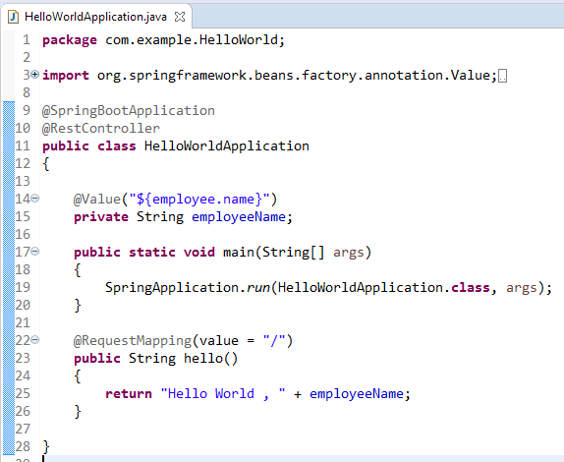

How to use @Value annotation with default value in Spring Boot?
The @Value annotation is used to read the environment or application property value in Java code.
If the property is not found while running the application, Spring Boot throws the Illegal Argument exception as Caused by: java.lang.IllegalArgumentException: Could not resolve placeholder 'employee.name' in value "${employee.name}“
To resolve the placeholder issue, we can set the default value for the property

Slide 2
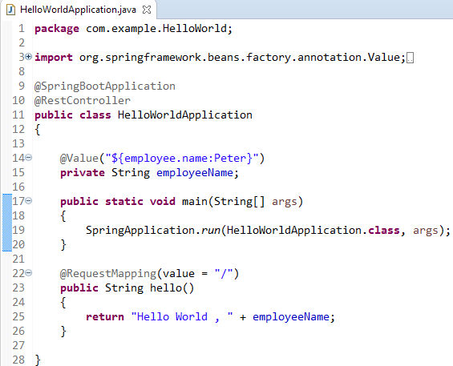
How to use @Value annotation with default value in Spring Boot?
@Value("${property_key_name:default_value}")
We can set the default value for the property using this syntax

